Slide 1
UBER FARES ANALYSIS
PRESENTER: BABWIRE YESU DENIS

Slide 2
Introduction
This report presents an analytical exploration of the Uber Fares dataset using Python for data preprocessing and Power BI for interactive visualization. The goal is to uncover insights into fare patterns, ride frequency, and time-based trends that influence Uber operations. By cleaning and enhancing the dataset with additional features such as hour, weekday, and peak time indicators, we are able to generate a clear and data-driven view of ride behavior in terms of time, geography, and fare variability.

Slide 3
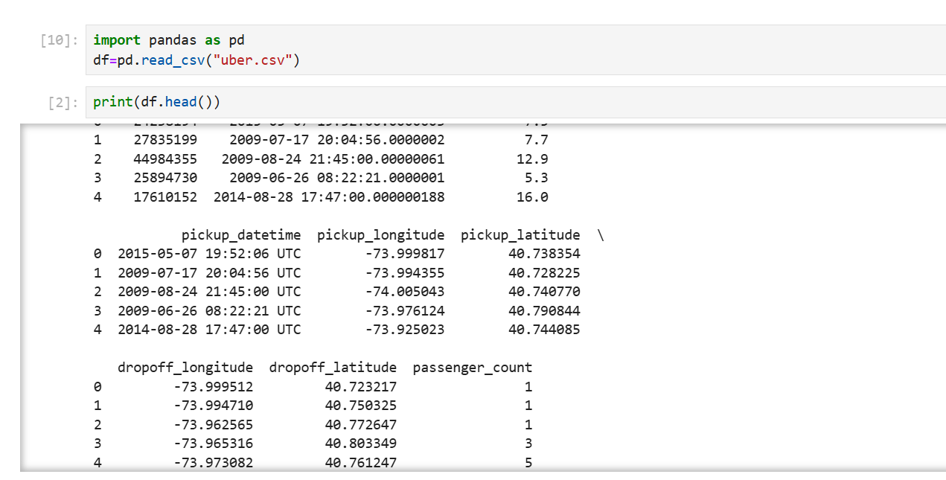

Slide 4
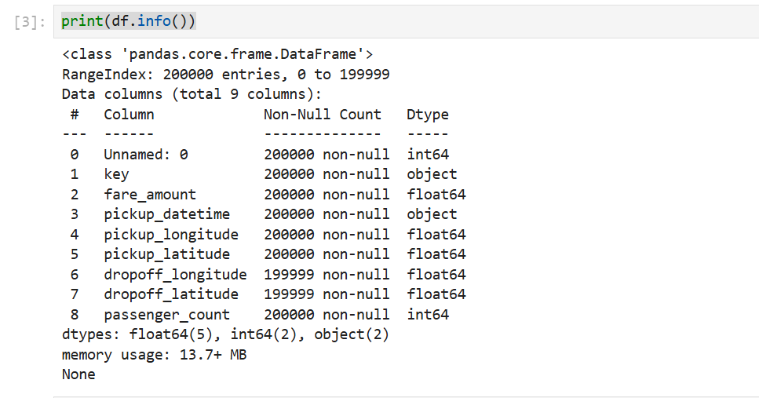

Slide 5
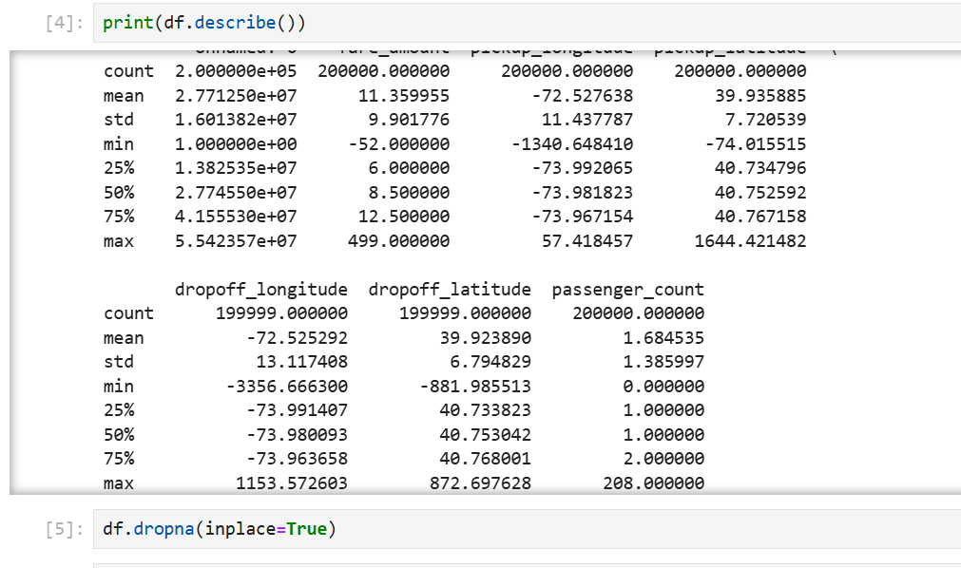

Slide 6
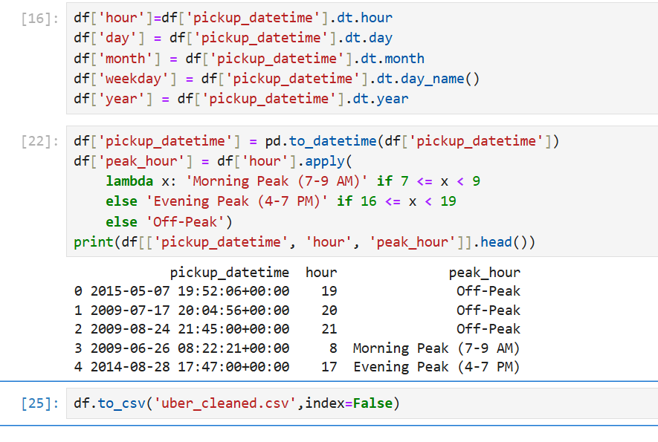

Slide 7
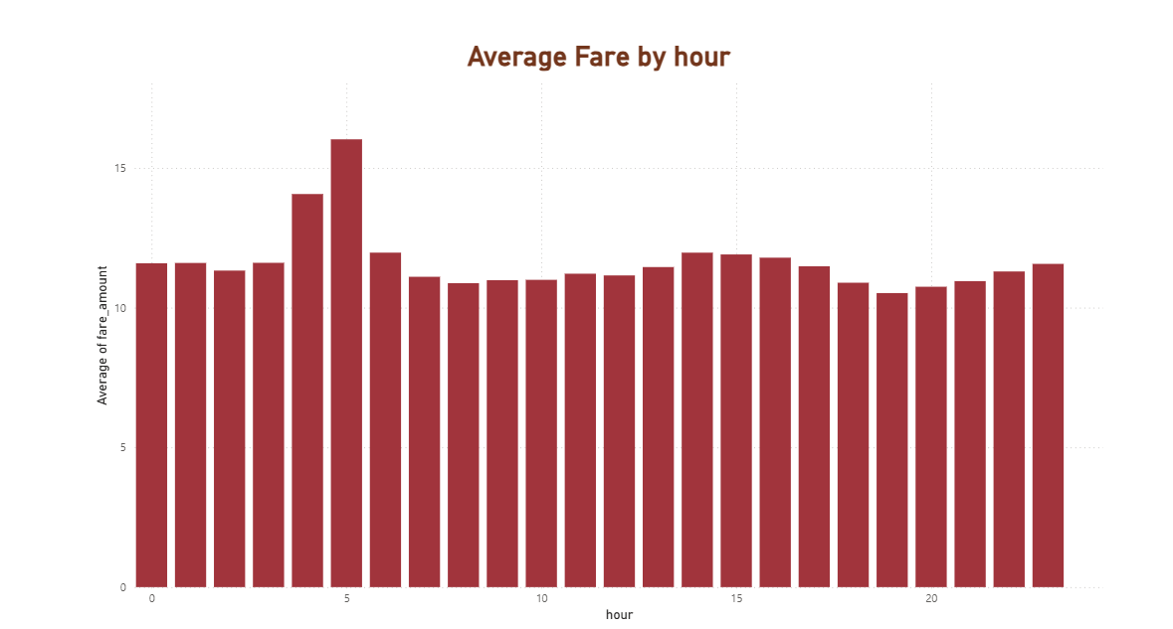

Slide 8
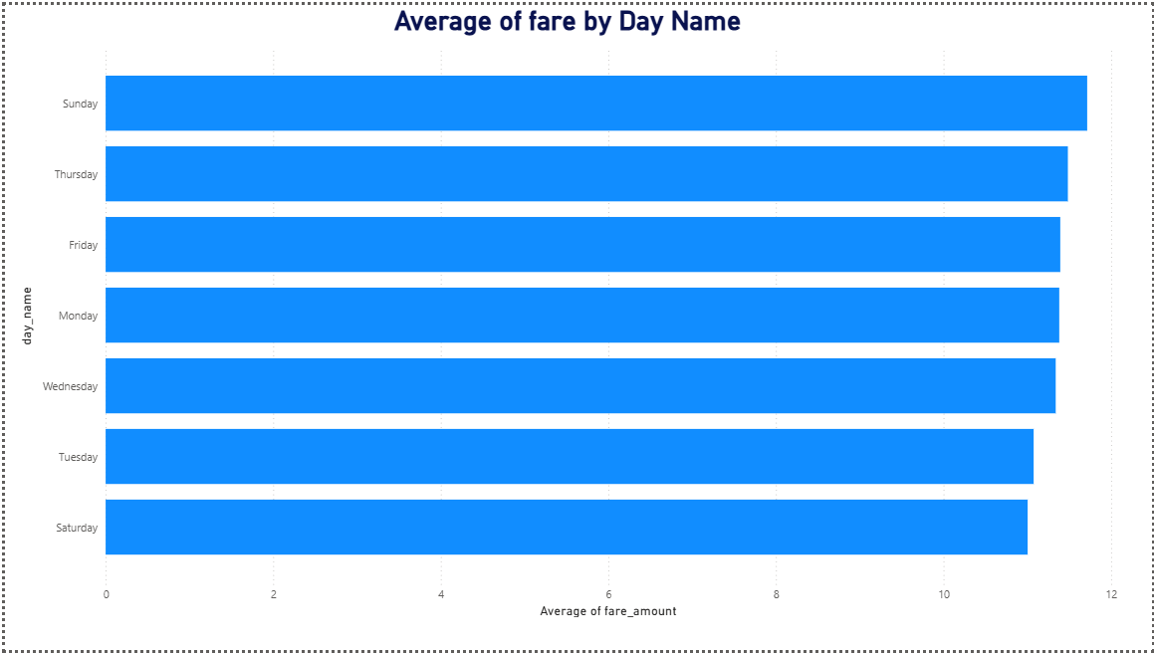

Slide 9
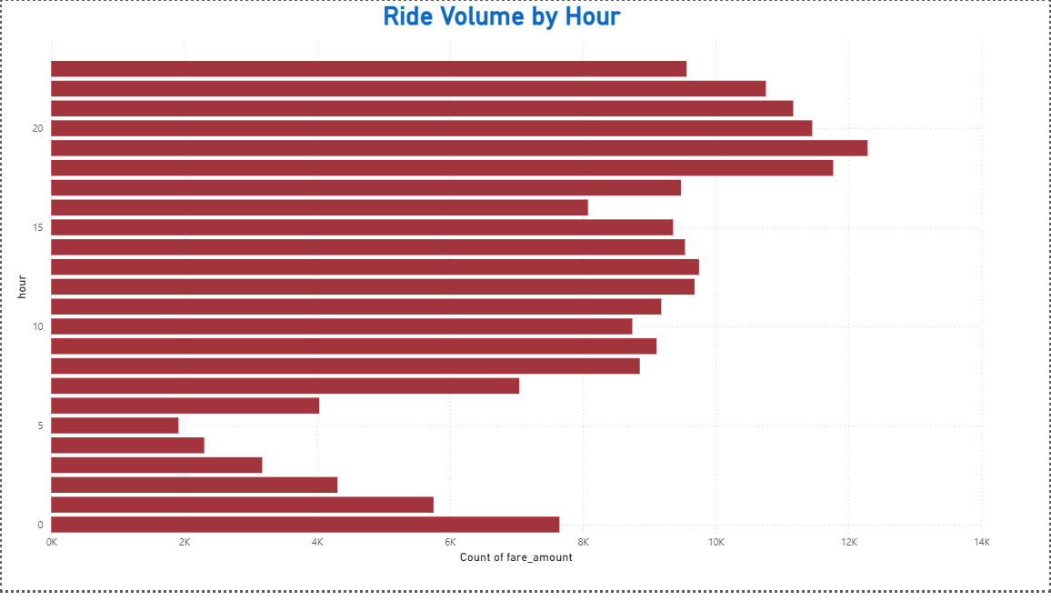

Slide 10
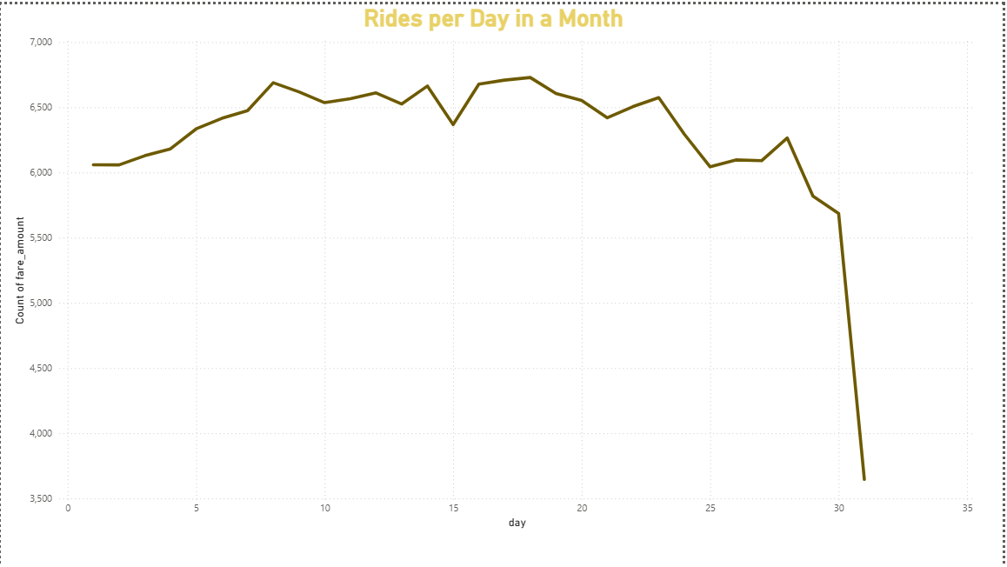

Slide 11
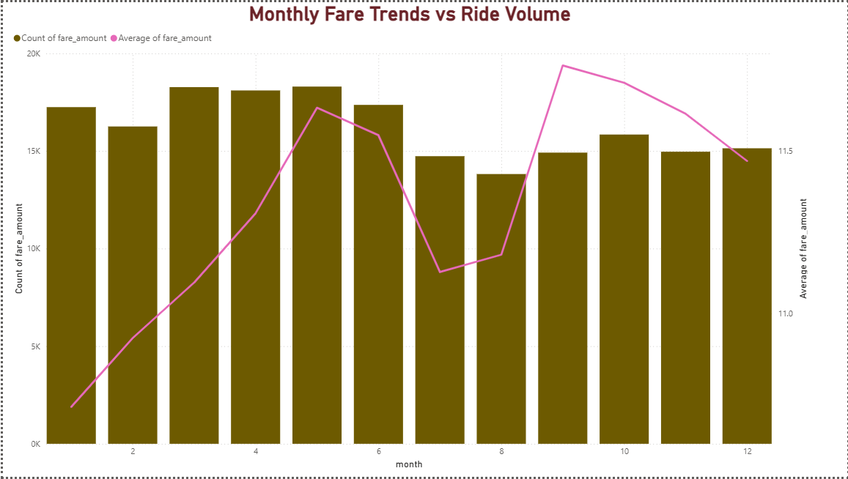

Slide 12
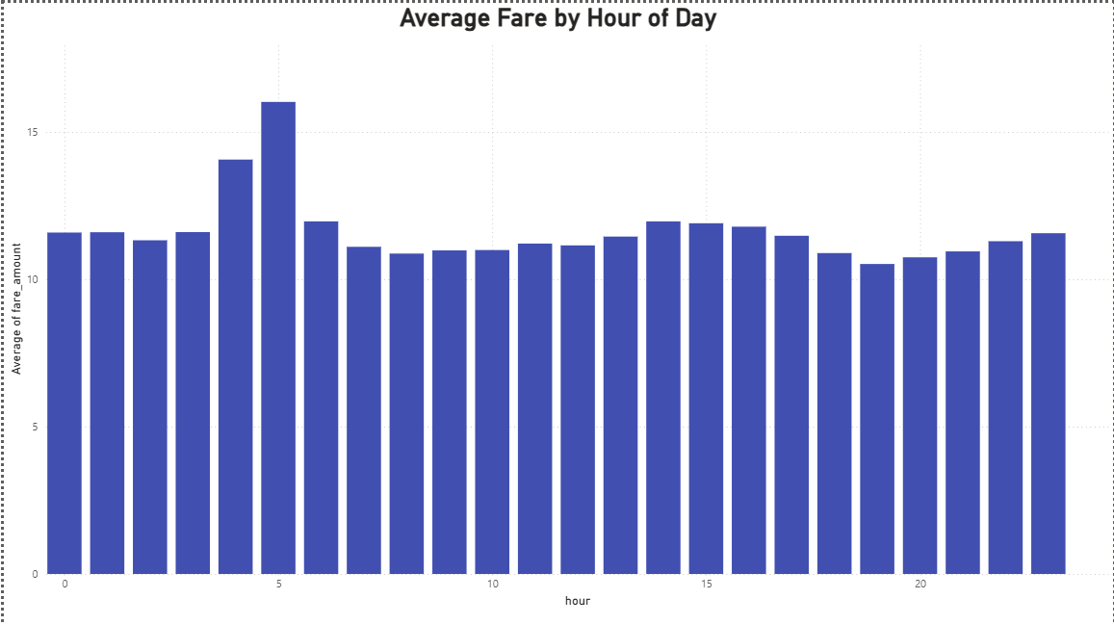

Slide 13
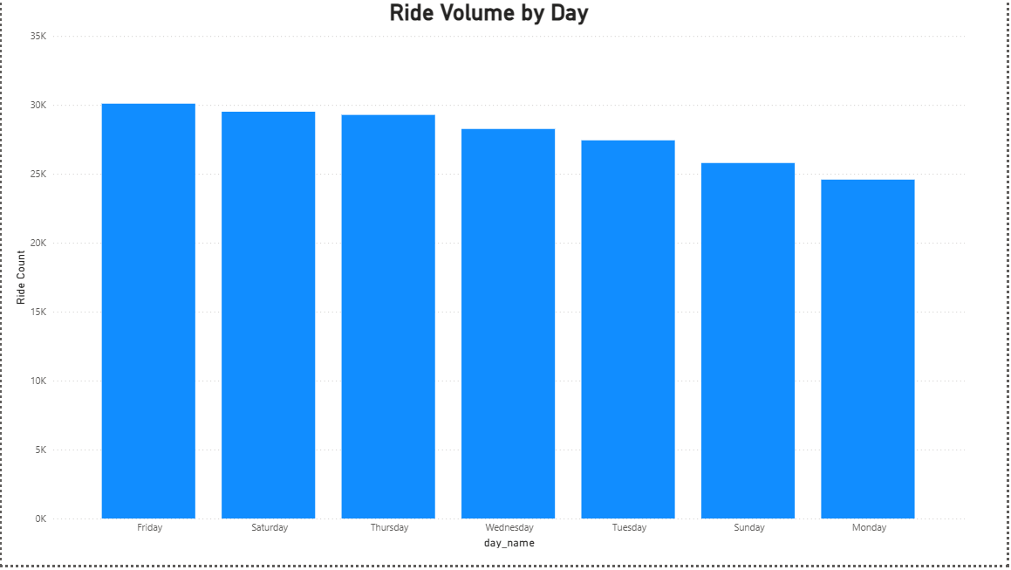

Slide 14
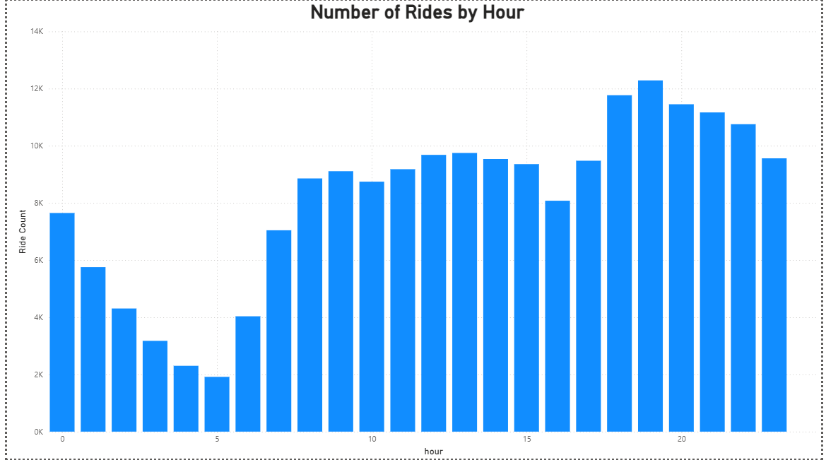

Slide 15
Conclusion
The analysis revealed key patterns in Uber ride activity, including fare fluctuations by time of day and day of the week, higher ride volumes during peak hours, and spatial clustering in urban regions. These insights, visualized through dynamic charts and maps, can help inform business decisions such as pricing strategies, peak-time resource allocation, and customer demand forecasting. Overall, this dashboard provides a powerful foundation for ongoing data-driven decision-making in the transportation domain.

